Slide 1
Inventory Measurement Tutorial
Mike Montross michael.montross@uky.edu
Sam McNeill sam.mcneill@uky.edu
Aaron Turner apturne@clemson.edu

Slide 2
Purpose of Excel Inventory Model
Track incoming and outgoing grain based on scale weights
Estimate quantity of grain stored in bins including packing
Official scale weights are the standard, estimating inventory in the bin has a high level of uncertainty. Entering into contracts based on bin measurements or on-farm weights is not advised.

Slide 3
Excel Inventory Model
Four tabs
Summary
BinData
Inventory
ScaleLog
Ignore Summary tab for now. Uses pivot tables to summarize results.
Two hidden sheets with formulas, conversions, and other data

Slide 4
Model Farm
Four bins
Bin 1 is 30 ft diameter and height of 30 ft to the bottom of the manhole
Bin 2 is 24 ft diameter and height of 24 ft to the bottom of the manhole.
Bin 3 is 48 ft diameter and height of 48 ft to the bottom of the manhole
Overhead is a hopper bottom overhead tank. Diameter is 12 ft and height of the cylinder is 9 ft. The hopper has an angle of 45°.

Slide 5
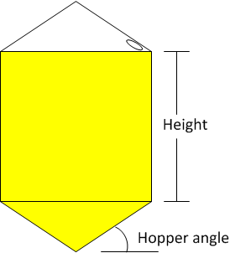
Hopper Bins
Height is distance from manhole to the top of the hopper
Also called cylinder height

Slide 6
Excel Inventory Model
Four tabs
Summary
BinData
Inventory
ScaleLog

Slide 7
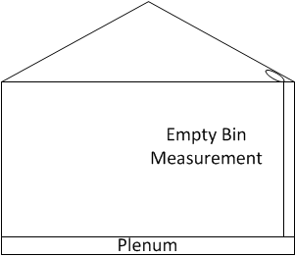
BinData Sheet
Only done once
Need diameter
Or Diameter = circumference/3.14
Measurement from reference point to bottom when empty
Bottom lip of manhole convenient location
Usually assume that is maximum fill for the bin

Slide 8
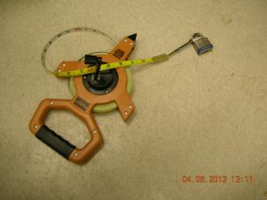
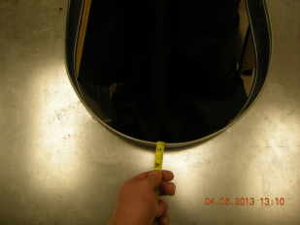
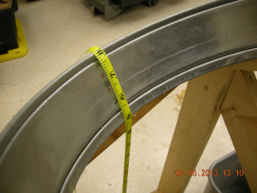
Bin measurement

Slide 9
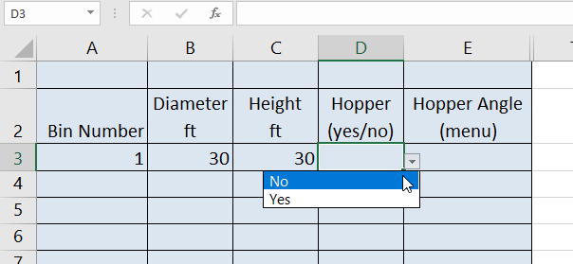
BinData Sheet
Enter bin 1
Column A – number or name
Column B – diameter, ft
Column C – height, ft
Lip of manhole to floor
Column D - Hopper (drop down yes or no)
Column E – only applies if D is yes

Slide 10
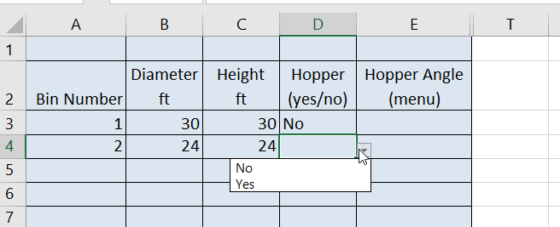
BinData Sheet
Enter bin 2
Column A – number or name
Column B – diameter, ft
Column C – height, ft
Column D - Hopper (drop down yes or no)
Column E – only applies if D is yes

Slide 11
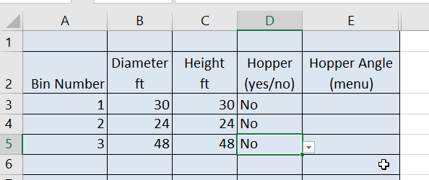
BinData Sheet
Enter bin 3

Slide 12
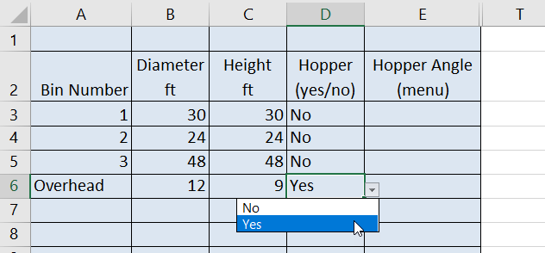
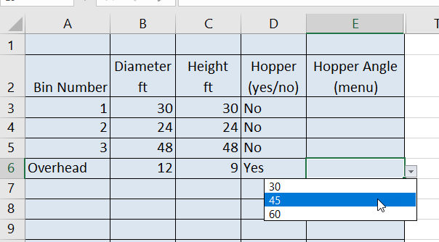
BinData Sheet
Enter Overhead bin
Column A – number or name
Column B – diameter, ft
Column C – height, ft
Column D - Hopper (drop down yes or no)
Column E – only applies if D is yes, 30, 45, 60°

Slide 13
Sheet ScaleLog
If you have scales, you can enter details of each load.
Also could enter net weight from yield monitor
These weights are used to compare to measured inventory
Wheat harvest occurs over 10 days July 1 – July 10. One load per day. Each load is 50,000 lb. Moisture is 16% until July 7, then 13%. Test weight is 58 lb/bu until July 5, then 60 lb/bu

Slide 14
ScaleLog Sheet
First load – row 2
7/1/19 – column A2
Operation – column B – drop down for in or out. Used to balance inventory with scale.

Slide 15
ScaleLog – Weight Data
Column C - Loaded weight, lb
Column D – Empty weight, lb
Column E – Calculation for net weight
If only net weights used - enter here

Slide 16
ScaleLog – Commodity data
Column F – Drop down menu for commodity
Column G – Moisture content, % wet basis
Column H – Test weight, lb/bu

Slide 17
ScaleLog – Commodity data
Column G – Moisture content, % wet basis
Column H – Test weight, lb/bu
Column I – Standard bushels – see next slide

Slide 18
Standard Bushels
Everything is shrunk or weight added to make standard bushels
Data on hidden sheet, can be changed
Corn at 16% - weight reduced to achieve 15%
Corn at 14% - weight added to achieve 15%
This would assume all grain is blended and marketed at desired moisture content shown in table
Crop | MC % wb | TW lb/bu
Corn | 15 | 56
Soybeans | 13 | 60
Wheat | 13 | 60
Milo | 15 | 56
Barley | 13 | 60
Rice | 13 | 60
Oats | 13 | 40

Slide 19
ScaleLog
Same conditions until July 4

Slide 20
ScaleLog
On July 5 – test weight changes to 60 lb/bu
Standard bushels are the same because 50,000/60 is 805
Test weight makes a difference on packing in inventory measurement sheet

Slide 21
On July 7, moisture goes to 13%

Slide 22
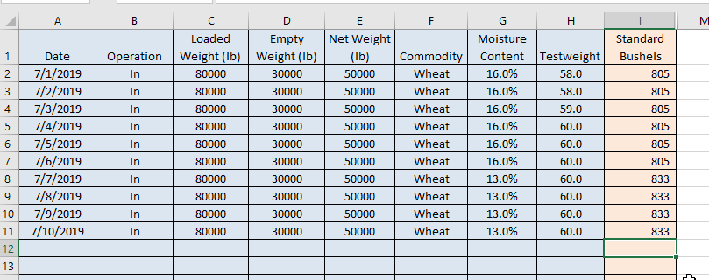
End of wheat harvest

Slide 23
Note on bushel calculation
Moisture content is not a grade factor
To allow for a comparison between bin inventory and the scale log, everything is adjusted to standard moisture content bushels
Shrink factor applied to high moisture grain
Similarly, grain is adjusted up if it is too dry
Assume grain is perfectly blended

Slide 24
August 1 you measure the bins
Go to inventory sheet
Assume all wheat in bin 2
Column A - Enter date
Column B – drop down menu of bin numbers

Slide 25
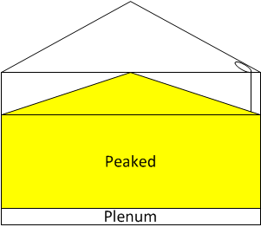
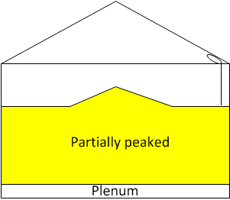
Note on grain surfaces
Five conditions are allowed
Peaked (i.e. after filling)
Partially peaked

Slide 26
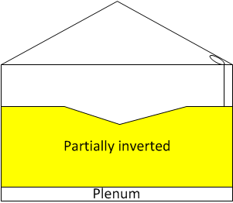
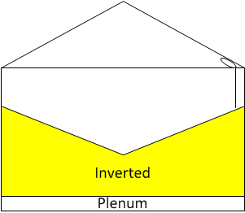
More surfaces
Partially inverted
Inverted

Slide 27
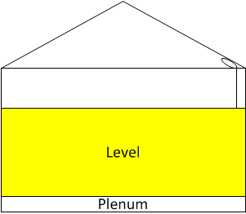
Level Surface
Level
Some adjusters always assume level height. The equivalent level change in a cone is 1/3 the height. So you could have a cone 10 ft tall, if it is pushed down into the bin to be level it would add 3.3 ft to the level height.

Slide 28
Surface measurement
32 inches below the manhole to the grain surface. The surface is peaked. Column D

Slide 29
Inventory
No hopper - Column E, no option
Bin has wheat – Column F

Slide 30
Grain conditions – MC and TW
Follow proper bin entry conditions. If it is not safe estimate MC and TW from dryer records, previous sales, etc.
I think it is 13.5% moisture and TW 59 lb/bu

Slide 31
Bushel Calculation
There are hidden columns that determine the pack factor. This increases the capacity in the bin.
The pack factor is a function of the test weight. Moisture content has no impact on pack factor.
Moisture content is used to adjust to standard bushels.
The difference between 8,668 and 8,618 bu is the due to the shrink factor from 13.5 to 13.0%.

Slide 32
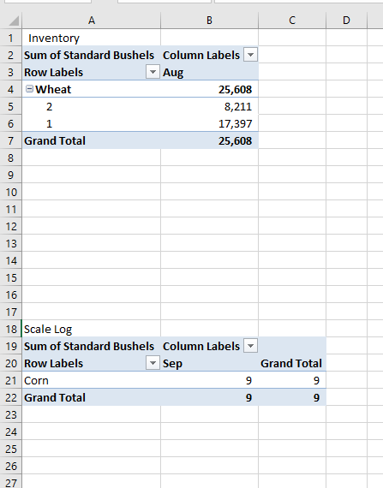
Summary-Bin
These are pivot tables, initially filled with left over data.
Means nothing until refreshed

Slide 33
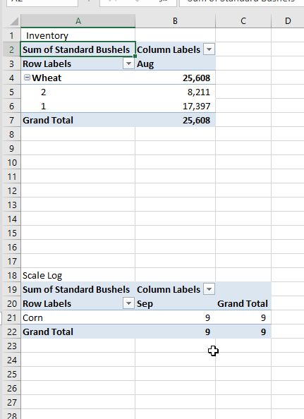
Refreshing pivot table
Select table by clicking in it (top one for now)
Click cell A2

Slide 34
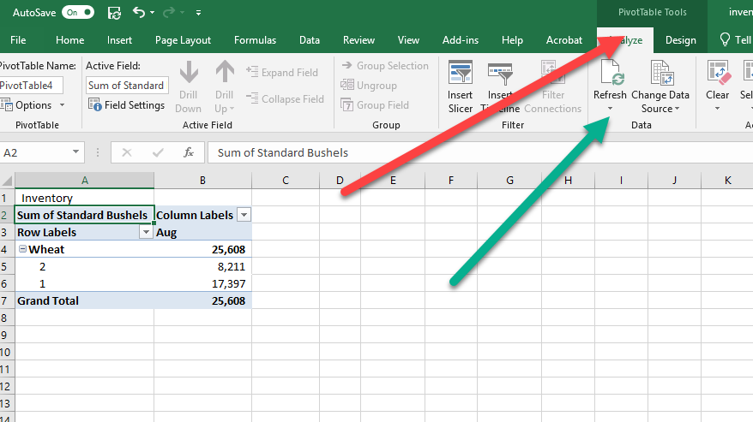
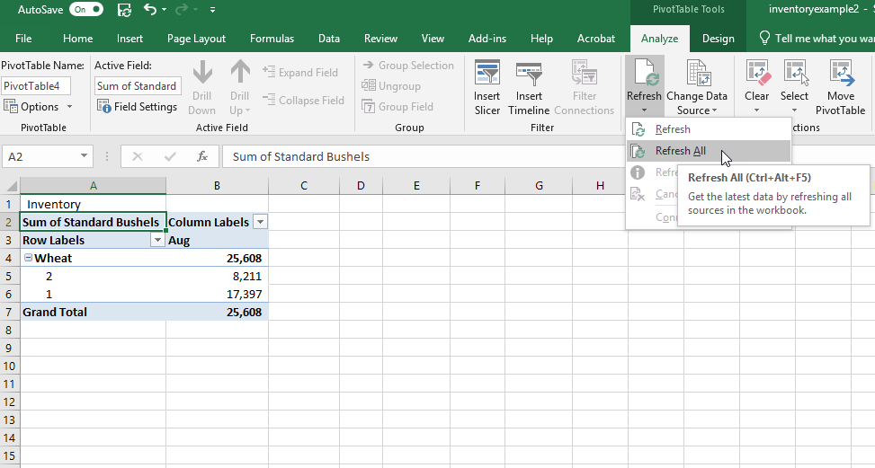
Update Pivot Table
First red arrow, analyze tab under pivotable tools
Then refresh key by green arrow
Use down arrow to refresh all

Slide 35
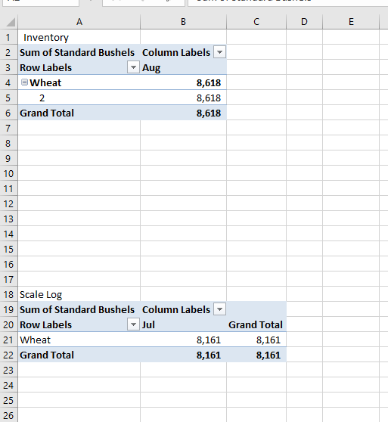
If scales available update that pivot table
According to inventory, bin 2 has 8,618 bu of wheat at at 13% moisture and 60 lb/bu
According to scales, 8,161 standard bushels should be stored. Again at 13% MC and 60 lb/bu

Slide 36
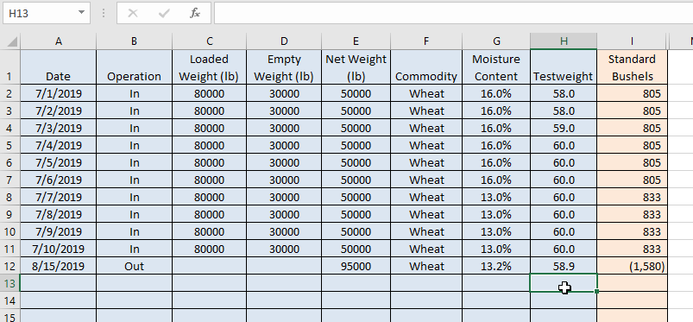
We sell a load of wheat on Aug 15
Scale log, Column B operation – out
I did not get loaded and empty weight, just use elevator data. Net weight was 95,000 lb. MC was 13.2% and TW 58.9. Negative 1,580 standard bushels

Slide 37
Inventory measured on 9/1
Inventory tab. Bin surface is inverted since cone pulled down.

Slide 38
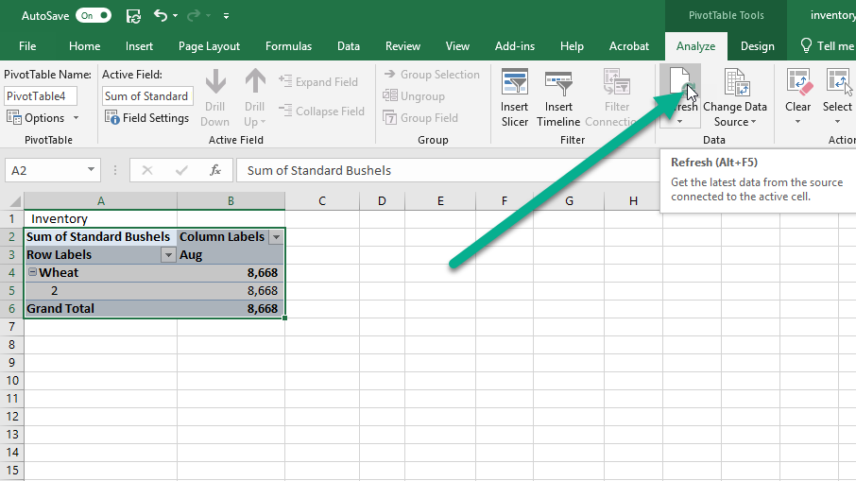
Update Summary-Bin Tab

Slide 39
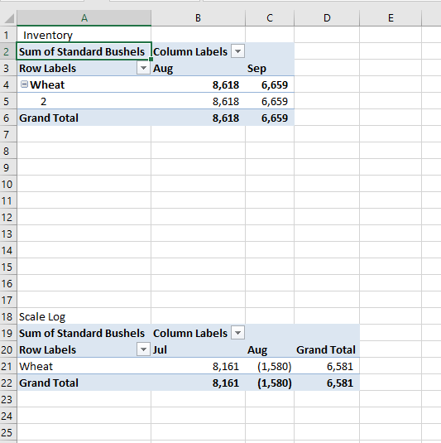
After refresh
August had 8,618 bu. When the report was run for September there was 6,659 bu.
From the scale log, a net of 8,161 bu was brought in July. In August 1,580 bu was removed. The based on scale data was 6,581 bu
There will always be a difference between the measurements.

Slide 40
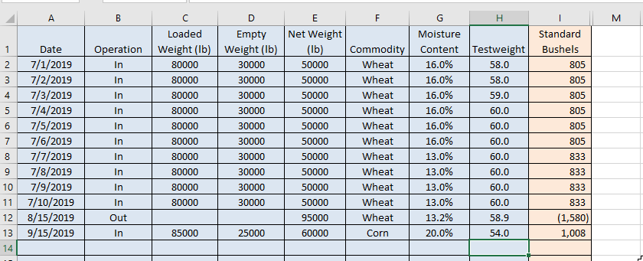
Now corn harvest – ScaleLog
Start Sept 15 first day
85,000 gross, 25,000 lb empty weight, 20% MC and 54 lb/bu

Slide 41
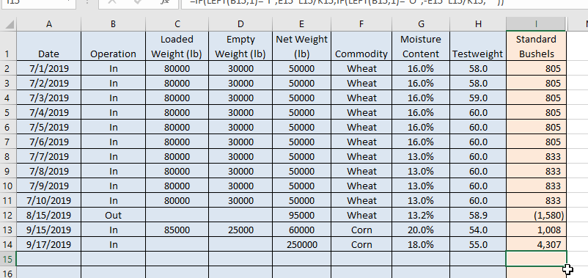
Two more harvest dates
Did not track individual trucks, just know that I harvest 250,000 lb of 18% and 55 lb/bu corn on 9/17

Slide 42
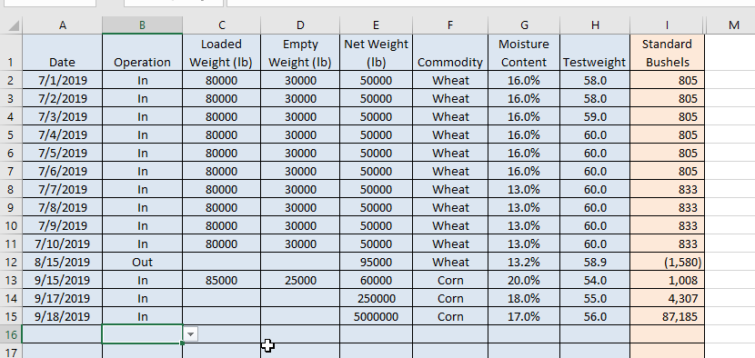
Two more harvest dates
Did not track individual trucks, just know that I harvest 5,000,000 lb of 17% and 56 lb/bu corn on 9/18

Slide 43
Inventory – Bin measurement
Go to inventory tab
On 10/1 we measured bin inventory
Still have wheat in bin 2. Measured 54 inches below man hole. Surface is an inverted cone. Last time measured 55 inches, but there will be operator variation

Slide 44
Data for Bin 1
Corn in bin 1. 16 inches below manhole. Column C.
Top grain surface is almost level (drop down menu column D)

Slide 45
Data for bin 1
No hopper, nothing in column E
Column F – corn, enter MC and TW in column G and H

Slide 46
Bin 3 Inventory
Corn in bin 3, still peaked from harvest

Slide 47
Inventory in Hopper Bottom Bins
Overhead

Slide 48
Inventory in Hopper Bottom Bins
Overhead
Height in column C is only the cylinder
Column E handles the cases when no grain is in the cylinder portion, but some could be in hopper
In farm bins, grain in the hopper is likely very small

Slide 49
Overhead bin
Corn was 55 inches down from manhole, so cylinder portion was partially filled. (Bin has a 9 ft cylinder height).

Slide 50
Overhead inventory
Surface is level
Since grain is in cylinder, hopper has to be full (column E)

Slide 51
Final inventory measurements

Slide 52
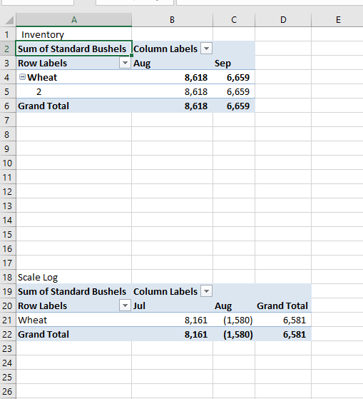
Refresh summary sheet
Click on a pivot table

Slide 53
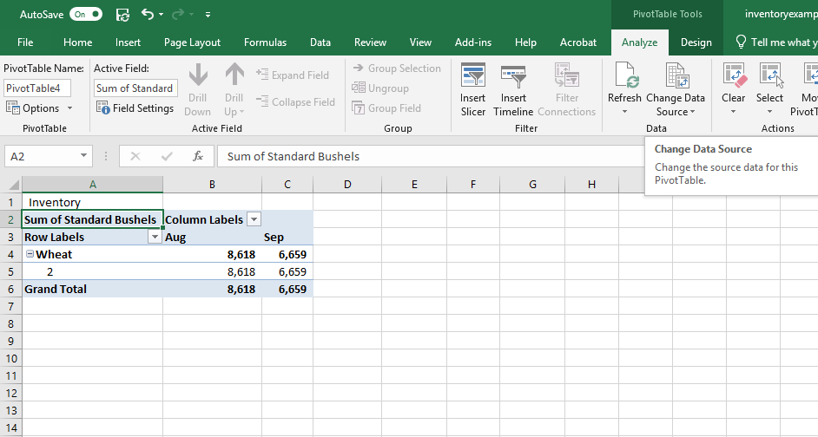
Refresh pivot table
Pivottable tools
Analyze

Slide 54
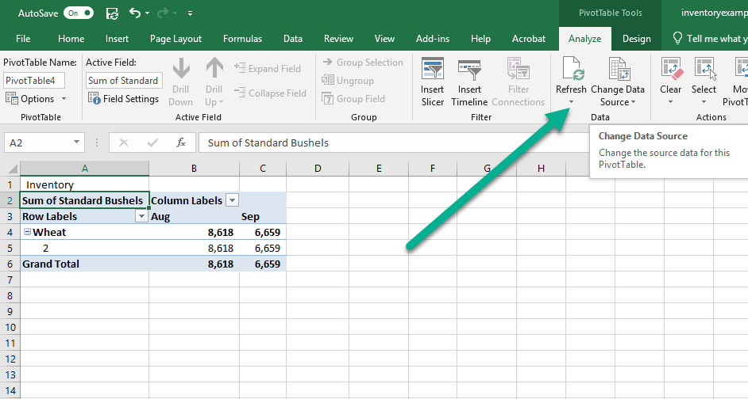
Arrow down for refresh

Slide 55
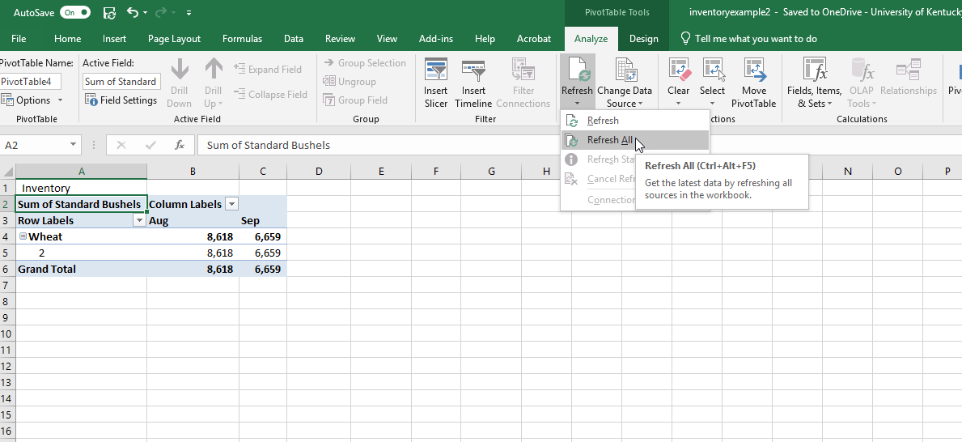
Refresh All

Slide 56
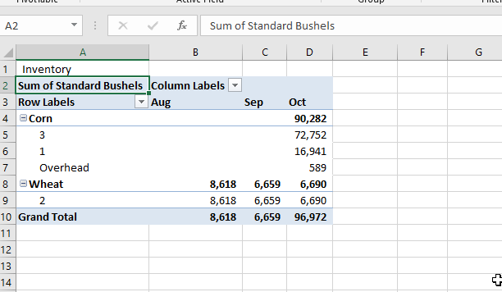
Results Bin Inventory
Bin inventory lists 90,282 bu of corn
72,752 in Bin 3
16,941 in Bin 1
589 in overhead
6,690 bu of wheat in bin 2

Slide 57
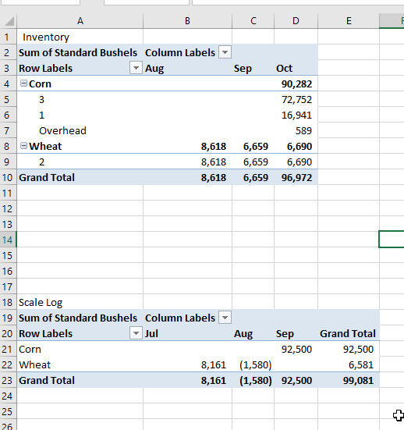
Scale Log Summary
According to scale log
92,500 bu of corn
6,581 bu of wheat

Slide 58
And 350,000 lb of 17.5% and 56 lb/bu corn on 9/19

