Slide 1
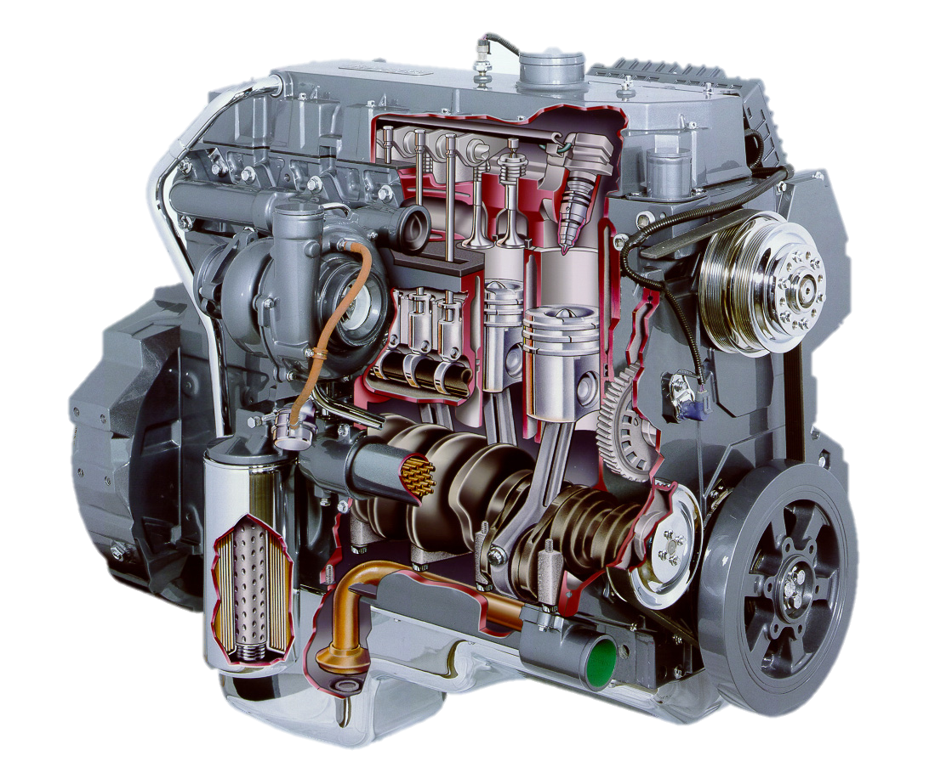
Valves and Timing
AEN/TSM 220

Slide 2
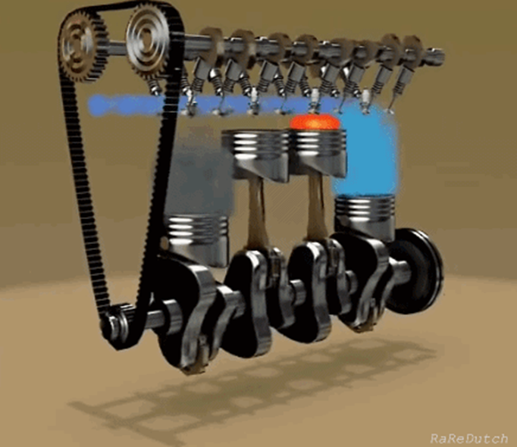
Roadmap
Valve Hardware
Location
Cam Shaft
Connecting Components
Adjustment/Timing

Slide 3
The Valve
Seal against high pressures
Allow gas flow
Withstand heat (material)

Slide 4
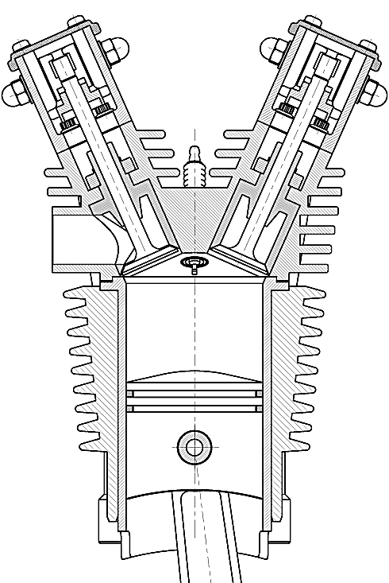
Valve Location

Slide 5
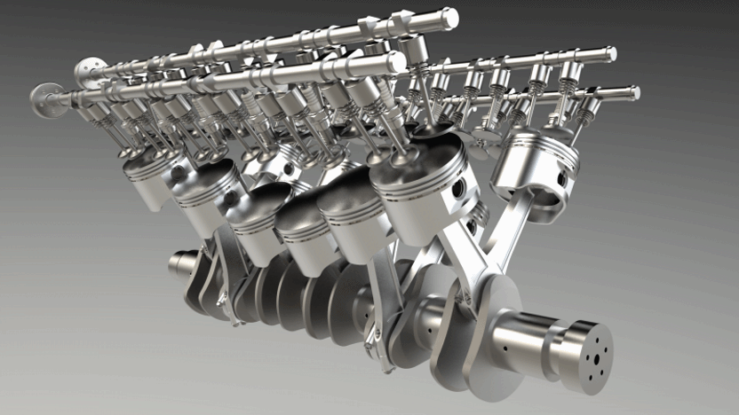
Multiple Valves

Slide 6
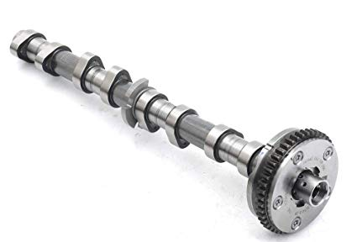
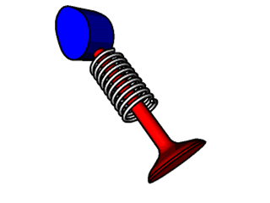
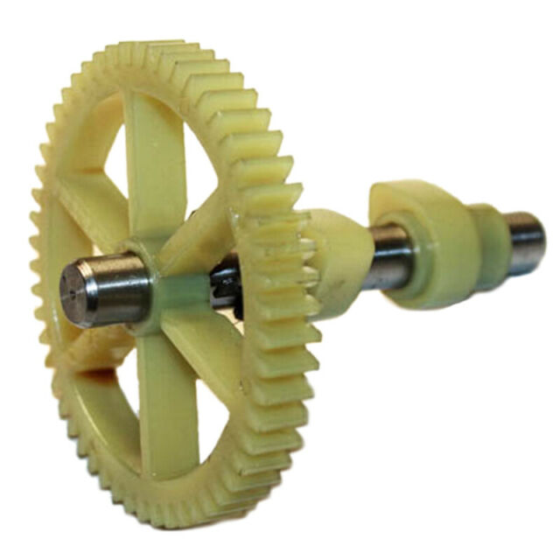
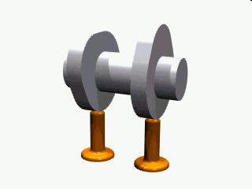
Cam Shaft

Slide 7
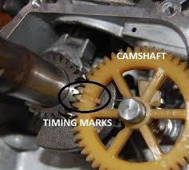
Cam Shaft Location

Slide 8
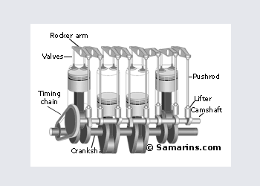
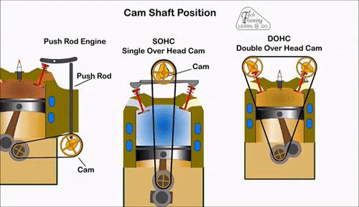
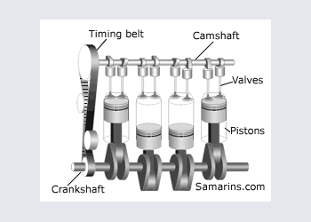
Overhead Cam

Slide 9
Connecting Hardware

Slide 10

Valve Adjustment and Timing

Slide 11
Adjustment

Slide 12
